Slide 1
Team 55: National Firefighter Registry
In Collaboration with CDC-NIOSH
10/17/2020

Slide 2
Team 55: Personnel
Team 55 Members:
James Davis
Haolong Yan
Rahul Nowlakha
Joe Kurokawa
Traver Clifford
Eric Mammoser*
*New member, will act as QA
CDC Mentors:
Jill Raudabaugh
Breanna Newton
GT Mentor:
Elizabeth Shivers

Slide 3
Agenda
Architectural Update
JSON Parser Update
XML Parser Update
FHIR Validation Update
DB Update
QA Update
Project Plan Update
Plans for Upcoming Weeks

Slide 4
Architectural Update
Decided to move conversion of JSON/XML to common format to after the FHIR server response
Old: Convert XML to JSON and then POST JSON only
New: Post XML/JSON directly, convert response to Python dictionary
As a result, will no longer use the fhirclient.py library and instead roll the FHIR validation code into the JSON/XML handling
Notes:
References:
Health risks: https://www.cdc.gov/niosh/firefighters/health.html

Slide 5
Updated Diagram
Only change here is the update to use requests instead of fhirclient
Notes:
References:
Health risks: https://www.cdc.gov/niosh/firefighters/health.html

Slide 6
JSON Parser Update
NDJSON can be handled using ndjson Python library
Updated to use requests library to handle JSON formatted POST to FHIR server
Notes:
References:
Health risks: https://www.cdc.gov/niosh/firefighters/health.html

Slide 7
XML Parser Update
Directly pulled in XML and was able to POST it to FHIR server using an HTTP request
Was able to POST a bundle of patient resources to server
Currently debugging spurious characters in the XML response after conversion to a Python dictionary using library xmltodict

Slide 8
FHIR Validation Update
This is no longer a separate task; it has been integrated into the JSON and XML Parser sections since these will do an HTTP request on their own

Slide 9
DB Update
GUI up and running, able to view table created
Worked through Docker settings issue causing an issue when trying to run the database create script

Slide 10
QA Update
Personnel change here, as Eric is taking over from Michael
Validated that Dockerfile was able to stand up the DB
Was able to access DB using the GUI

Slide 11
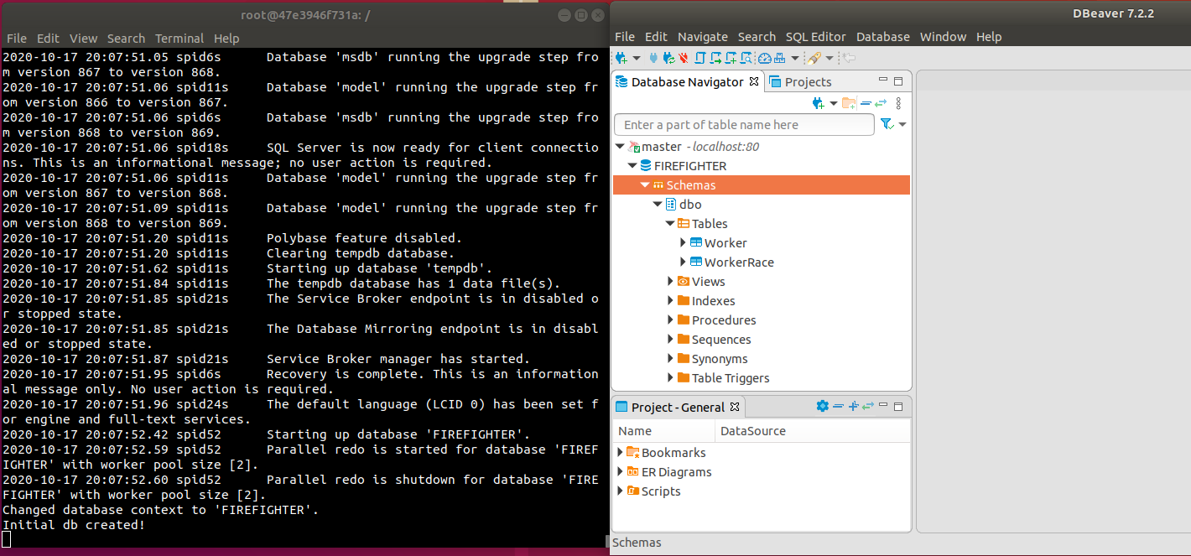
QA Screenshot
Docker on left, DBeaver GUI on right

Slide 12
Project Plan Update

Slide 13
Plans for Future Weeks
Update JSON and XML parser code to handle conversion of FHIR server response to common data format to be passed to SQL insertion code
Begin mapping FHIR resources to DB fields to support DB population
QA to validate implemented code for parsers
JSON/XML parsers to be updated pending any QA feedback

